Slide 1



Routing Information Protocol (RIP)
Presented By:
Prakiran Thapa
Swornim Poudel
Bishal Oli

Slide 2
Routing Information Protocol (RIP) is a dynamic routing protocol that uses hop count as a routing metric to find the best path between the source and the destination network. It is a distance-vector routing protocol that has an AD value of 120 and works on the Network layer of the OSI model. RIP uses port number 520.

Slide 3
How does RIP works ?
RIP works by routers talking to each other, sharing which networks they can reach and how far away those networks are in terms of router hops. Routers then use this information to figure out the best paths to send data across the network. Periodically, routers update each other with any changes so they always have the most current map of the network.

Slide 4
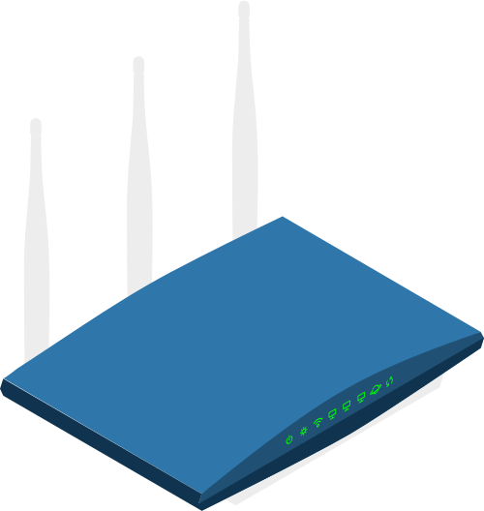
Features of RIP
1. Updates of the network are exchanged periodically.
2. Updates (routing information) are always broadcast.
3. Full routing tables are sent in updates.
4. Routers always trust routing information received from neighbor routers. This is also known as Routing on rumors.

Slide 5
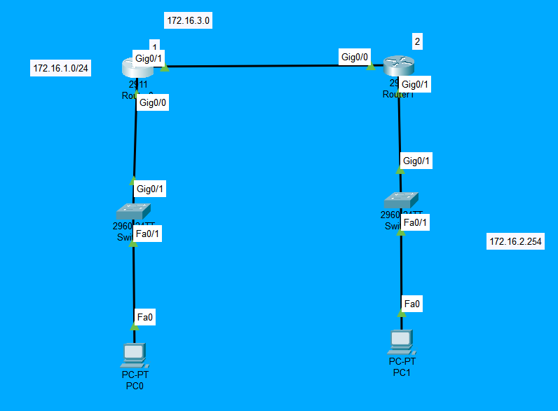

Slide 6
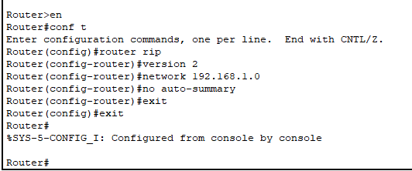
RIP Configuration
Access the router's CLI.
Enter global configuration mode.
Enable RIP routing protocol.
Specify RIP version.
Advertise the network.
Optional: Disable auto-summarization

Slide 7
Advantages of RIP :
Simplicity: RIP is a relatively simple protocol to configure and manage, making it an ideal choice for small to medium-sized networks with limited resources.
Easy implementation: RIP is easy to implement, as it does not require much technical expertise to set up and maintain.
Convergence: RIP is known for its fast convergence time, meaning that it can quickly adapt to changes in network topology and route packets efficiently.

Slide 8
Disadvantages of RIP :
Limited scalability: RIP has limited scalability, and it may not be the best choice for larger networks with complex topologies. RIP can only support up to 15 hops, which may not be sufficient for larger networks.
Slow convergence: While RIP is known for its fast convergence time, it can be slower to converge than other routing protocols. This can lead to delays and inefficiencies in network performance.
Routing loops: RIP can sometimes create routing loops, which can cause network congestion and reduce overall network performance.

Slide 9
CONCLUSION
RIP is simple for smaller networks but may not scale well. Larger networks benefit from more advanced protocols like OSPF or EIGRP, which offer better performance and features. Understanding RIP's limits helps in choosing the right protocol for network needs

